Slide 1
UNIX
COMMANDS
Presented by : Sahablal Bind

Slide 2
Contents
cd command
mkdir & mv command
ls command
chmod,chown,chgrp command
grep and find command
cat and date command
wc command
awk command
Sed command
Sort and rm command
diff and tkdiff command
less command
more command
touch command
vi editor
gvim command
Shell Scripting

Slide 3


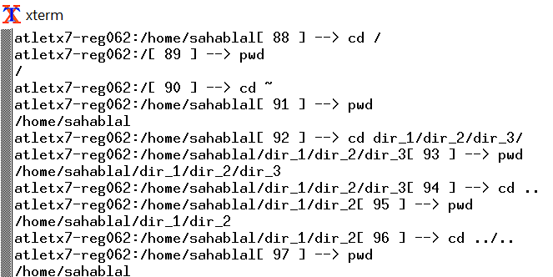
cd command
cd / :By using this command ,we can go to the root directory and root directory is the first directory.
cd ~ :Using this command, we can go to home directory.
cd - :Using this command, we can move to last directory.
cd .. : By using this, we can move to the parent directory of current directory, or the directory one level up from the current directory. “..” represents parent directory.
cd dir_1/dir_2/dir_3 :We can move to any directory by using the path of that directory.
pwd : we can get the information of the present working directory.
Tip
We can take use of arrow up key from the keyword to go to the previous command which were performed on the terminal.

Slide 4
mkdir & mv command
mkdir filename :By using this command ,we can create the directory with name filename.
mkdir -p dir_1/dir_2/dir_3 :Using this command, we can add directory including its sub directory.
mkdir -v filename :Using this command,It displays a message for every directory created.
mkdir -m [options] filename :This command is used to set the file modes, i.e. permissions, etc. for the created directories. The syntax of the mode is the same as the chmod command.
mv file1 file2 : By using this, we can move the content in the file2 from file1 or simply saying renaming the filename. After this option file1 will not present in the directory.
Mv -f file1 :
Tip
Command with space and “—help” will provide the help regarding more command related to it.

Slide 5
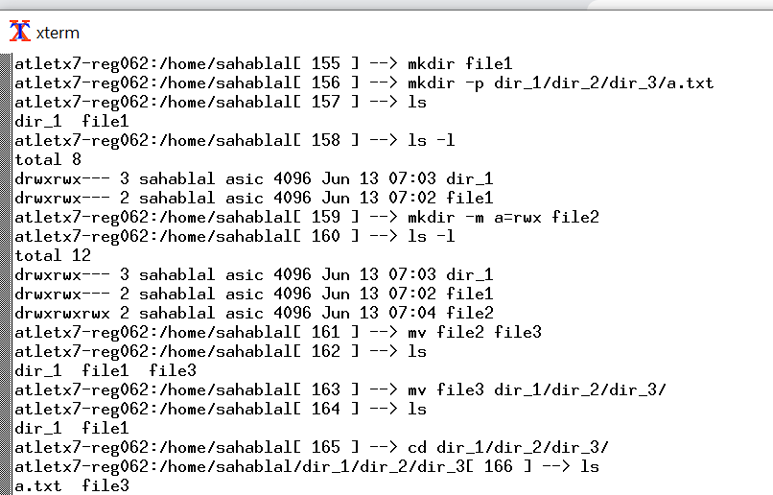
mkdir & mv command

Slide 6
ls command
ls :Listing the files and directory in the current directory.
ls -l :Using this command, we can get the details of the each files and directory in the current directory like date,time,permissions,owner etc.
ls -a :Represent all files Include hidden files and directories in the listing.
ls -t :Sort files and directories by their last modification time, displaying the most recently modified ones first.
ls -r :Reversing order of listing.
ls -S :Sort files and directories by their sizes, listing the largest ones first.
ls -R : List files and directories recursively, so that we can observe the file including subdirectories clearly.
ls -i:known as inode which displays the index number (inode) of each file and directory.inode is unique identifier number of each file.
ls -g :It displays the group ownership of files and directories instead of the owner.
ls -h :Print file sizes in human-readable format (e.g., 1K, 234M, 2G).
ls -d :List directories themselves, rather than their contents.
ls ch*.doc : This command lists the file which starts with ch and end extension is .doc
Tip
ls -l command gives most of the details of the file and directory like date,time,permission,owner,path etc.Each column give certain information.

Slide 7
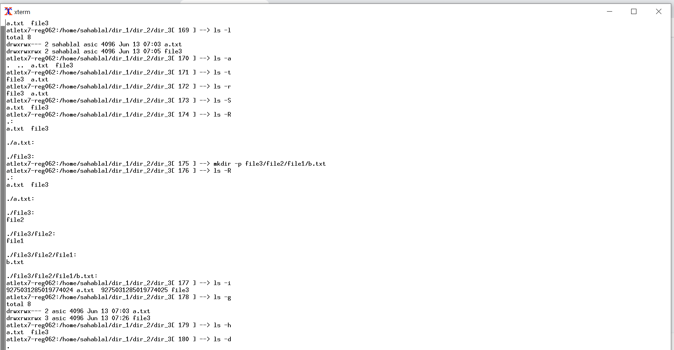
Continue …

Slide 8
chmod,chown & chgrp
Chmod:
Read (r), Write(w), Execute (x)
Owner (u), Groups (g), Others (o)
:The specified permission(s) are added to a file or directory.
:Removes a file or directory specified permission(s).
= :Sets the designated permission(s).
chmod o+wx testfile :Adds write and execute permission to others in testfile.
Octal Permission Representation:
0-> No permission
1-> Execute
2-> Write
4->Read
chmod 777 testfile :Setting all permission
chmod 743 testfile :Owner adds all permission,Adds Read permission to groups , write & execute permission to others.

Slide 9
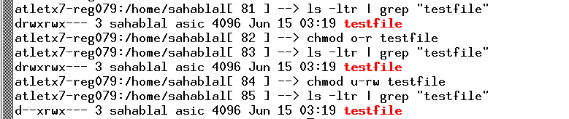
Continue …
chown : The chown command (which stands for "change owner") is used to change the owner of a file.
chgrp : The chgrp command stands for "change group" and is used to rename a file's group.
chown user filelist :The chown command changes the ownership of a file.
chgrp group filelist :The chrgp command changes the group ownership of a file

Slide 10
grep command
grep “testfile” :This command is used to find the file which is testfile.
grep -v “testfile”:Print all lines that do not match pattern.
grep -n “testfile” :Print the matched line and its line number.
grep -l “testfile” :Print only the names of files with matching lines
grep -c “testfile” :Print only the count of matching lines
grep -i “testfile” :Match either upper- or lowercase(case insensitive)
find command:
Find all text files in the current directory:find . -name "*.txt"
Find files modified within the last 7 days:find /path/to/search -type f -mtime -7
Find directories larger than 1GB:find /path/to/search -type d -size +1G
Search for files with specific permissions:find /path/to/search -type f -perm 644

Slide 11
cat command
cat testfile :It will the show the content of the given file.
cat > testfile :Create the file with name testfile and after it produces terminal page where we can provide the data and also exit with ctrl+ d.
cat >> testfile :Append the data into the existing file name “testfile”.
cat -n testfile : To view contents of a file preceding with line numbers.
cat testfile testfile1 : Copy the contents of one file to another file Command.
cat -s testfile : suppress repeated empty lines in output.
tac testfile : Will display content in reverse order.
cat *.txt : Will show the content of all text files present in the folder.
date command:
Display the current date and time:date
Display the date in a specific format:date +"%Y-%m-%d"
Display the date and time of a specific timezone:TZ="India/Kolkata" date
Set the system date and time :sudo date -s "2023-06-16 10:30"

Slide 12
wc command
Basic syntax: wc [options] [file(s)]
Options:
-l: Count lines.
-w: Count words.
-c: Count characters.
-m: Count characters (bytes).
Examples:
Count lines, words, and characters in a file:wc file.txt
Count only the number of lines in a file:wc -l file.txt
Count the number of words in multiple files:wc -w file1.txt file2.txt
Count the number of characters in a file (including whitespace):wc -c file.txt
Count the number of characters in a file (in bytes):wc -m file.txt
Read input from standard input and count lines, words, and characters:cat file.txt | wc
Tip
Command with pipe gives more features to explore the wc command

Slide 13
awk command
awk command:
The awk command is a powerful text processing tool that allows you to manipulate and extract data from files based on patterns and actions.
Basic syntax: awk 'pattern { action }' [file(s)]
Examples:
Print the first field of each line in a file:awk '{ print $1 }' file.txt
Print lines that contain a specific pattern:awk '/pattern/ { print }' file.txt
Perform arithmetic calculations:awk '{ total = $1 + $2; print total }' numbers.txt
awk command with grep:grep "pattern" file.txt | awk '{ print $2 }'
awk command with sort:sort file.txt | awk '{ sum += $1 } END { print "Sum:", sum }'
awk command with head:awk '{ print $1 }' file.txt | head -n 5
awk command with tail:awk '{ print $1 }' file.txt | tail -n 10
awk command with sed:sed 's/pattern/replacement/' file.txt | awk '{ print length($0) }'

Slide 14
sed command
The sed command (stream editor) is used for performing text transformations on input streams or files.
Basic syntax: sed [options] 'command' [file(s)]
Examples:
Replace first occurrence of a pattern in a file:sed 's/pattern/replacement/' file.txt
Replace all occurrences of a pattern globally:sed 's/pattern/replacement/g' file.txt
Delete lines that match a pattern:sed '/pattern/d' file.txt
Append text to the end of each line:sed 's/$/ additional text/' file.txt
Perform multiple editing operations using a script file:sed -f script.sed file.txt

Slide 15
sort command
Tip
rm Command should be handled carefully as it removes the file and directory without having any backup.
Sort filename :Using this command, we can sort the file .
Sort -r filename :sorting in the reverse order.
Sort -nr filename :This command is used to sort a file with numeric data in reverse order.
Sort -u filename.txt: Unique sorting of the file ,which it prints the data only once if there is any repeated data.
rm command
The rm command is used to remove (delete) files and directories.
Basic syntax: rm [options] [file(s) or directory]
Examples:
Remove a file:rm file.txt
Remove multiple files:rm file1.txt file2.txt
Remove a directory and its contents recursively:rm -r directory/
Prompt for confirmation before deleting each file:rm -i file.txt
Remove a directory and its contents forcefully:rm -rf directory/

Slide 16
diff command
The diff command is used to compare files and identify differences between them.
Basic syntax: diff [options] file1 file2
Examples:
Compare two files and display the differences:diff file1.txt file2.txt
Generate a side-by-side comparison of two files:diff -y file1.txt file2.txt
Ignore whitespace differences when comparing files:diff -w file1.txt file2.txt
Compare two directories and display differences recursively:diff -r dir1/ dir2/
Tip
Command with space and “—help” will provide the help regarding more command related to it.
tkdiff command
tkdiff command is similarly work as diff command but using this command gives GUI interface to understand the differences in much more details .We can compare both the files sides by side to see the differences.

Slide 17
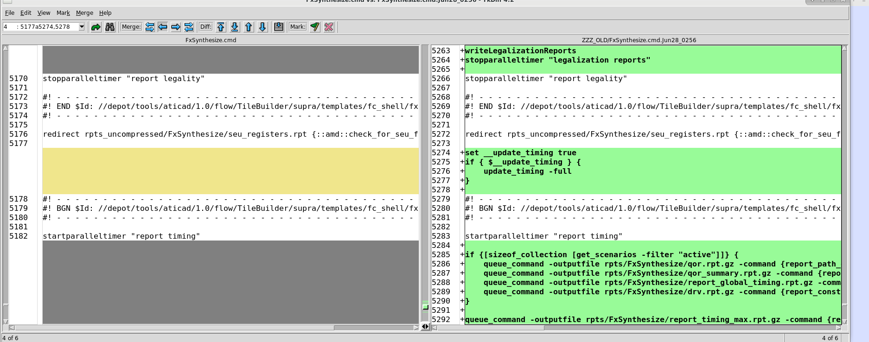
continue..

Slide 18
less command
The less command is a program for viewing files. It displays the contents of a file one screen at a time, allowing you to scroll up and down, search for specific text, and navigate within the file.
Basic syntax: less [options] [file]
Examples:
View a file using less:less file.txt
Navigate within the file:
Scroll down: Press the Spacebar or the j key.
Scroll up: Press the b key.
Go to the beginning of the file: Press g.
Go to the end of the file: Press G.
Quit less: Press q.
Tip
Command with space and “—help” will provide the help regarding more command related to it.

Slide 19
more command
The more command is similar to less in that it allows you to view the contents of a file one page at a time. However, it has fewer navigation features compared to less.
Basic syntax: more [options] [file]
Examples:
View a file using more:more file.txt
Scroll down one page: Press the Spacebar or the Enter key.
Quit more: Press q.
The primary difference between less and more is that less provides more extensive navigation and search capabilities, making it more flexible and powerful. On the other hand, more is a simpler command that allows basic scrolling through a file.
Tip
Command with space and “—help” will provide the help regarding more command related to it.

Slide 20
touch command
The touch command is used to create a new file .
Basic syntax: touch [options] [file]
Examples:
Create a new empty file:touch file.txt
Create multiple files at once:touch file1.txt file2.txt file3.txt
Tip
Command with space and “—help” will provide the help regarding more command related to it.

Slide 21
vi Editor
vi is a popular text editor available on Unix-like systems. It provides a command-line interface for creating, editing, and manipulating text files.
Basic usage:
Open a file for editing: vi file.txt
Enter insert mode to start editing: Press i
Save changes and exit: Press Esc and then type :wq!
Exit without saving changes: Press Esc and then type :q!
Some useful commands in vi:
Navigation: Use arrow keys or h (left), j (down), k (up), l (right)
Deleting text: x (delete character), dd (delete line)
Copying and pasting: yy (copy line), p (paste)
Undo and redo: u (undo), Ctrl + r (redo)
Searching: Press /, then type the search term and press Enter
Replace: :%s/old/new/g (replace all occurrences of "old" with "new")
Tip
vi Command with key control gives more accessibility.
Insert mode:press i
Command mode :
Press Esc

Slide 22
gvim command
gvim is a GUI version of the vi editor. It provides the same functionality as vi but with a graphical interface.
Basic usage:
Open a file for editing: gvim file.txt
Use the menu options, toolbar, and keyboard shortcuts for editing, saving, and exiting.
The commands and functionalities are similar to vi.
gvim examples:
Open a file for editing:gvim file.txt
Use the graphical interface to edit the file.
Save changes and exit:
Click on the "Save" button or press Ctrl + s.
Click on the "Close" button or press Ctrl + q.

Slide 23
Shell Scripting
Shell scripting is the process of creating and running command-line scripts to automate tasks in Unix-like operating systems. It involves using a shell scripting language (like Bash or sh) to execute commands, handle variables, control program flow, and manipulate files. Shell scripts are used to simplify repetitive tasks, configure system settings, and create custom utilities.
Comments:
Comments are used to add explanatory notes in the script. They are preceded by the hash character (#).
Example: # This is a comment
Variables:
Variables are used to store and manipulate data within a shell script. They are assigned values using the assignment operator (=).
Example: name="Siddarth"

Slide 24
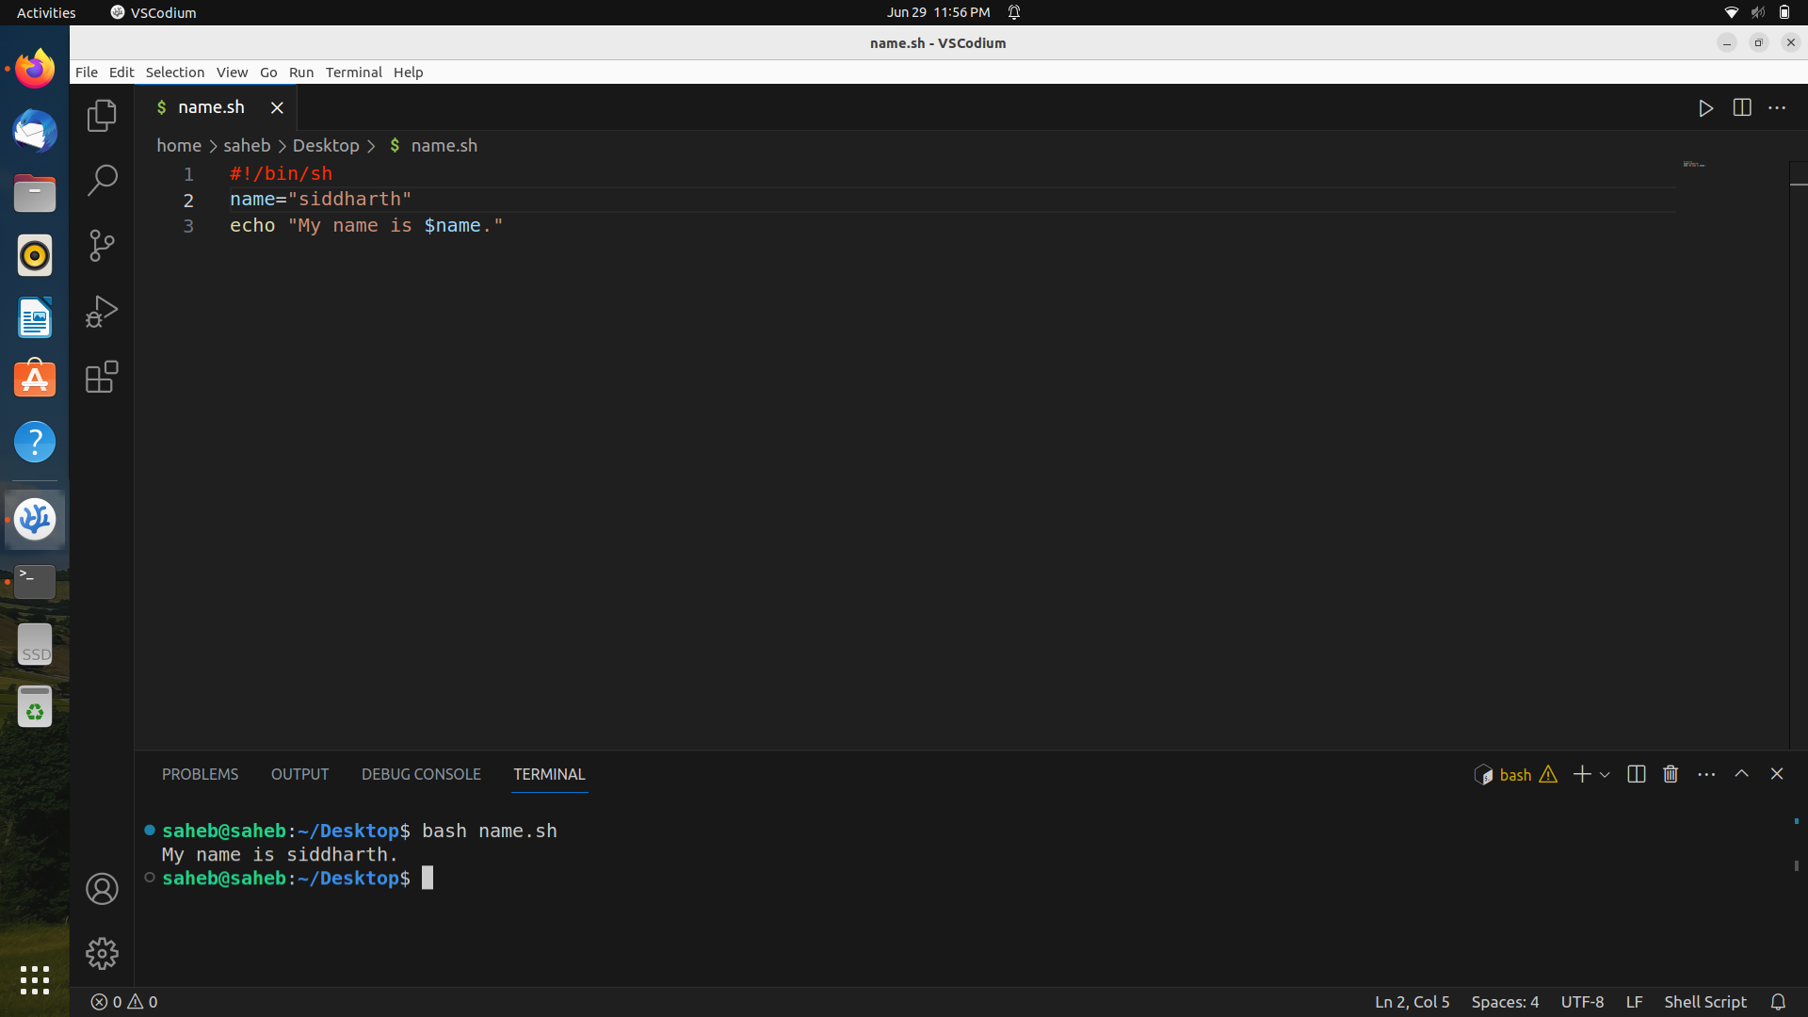
echo command
It is used to display text or variables on the terminal.
Displaying a message : echo Hello, World!
Printing the value of a variable: name="siddharth"
echo My name is $name
Redirecting output to a file:echo "I am new trainee" > output.txt

Slide 25
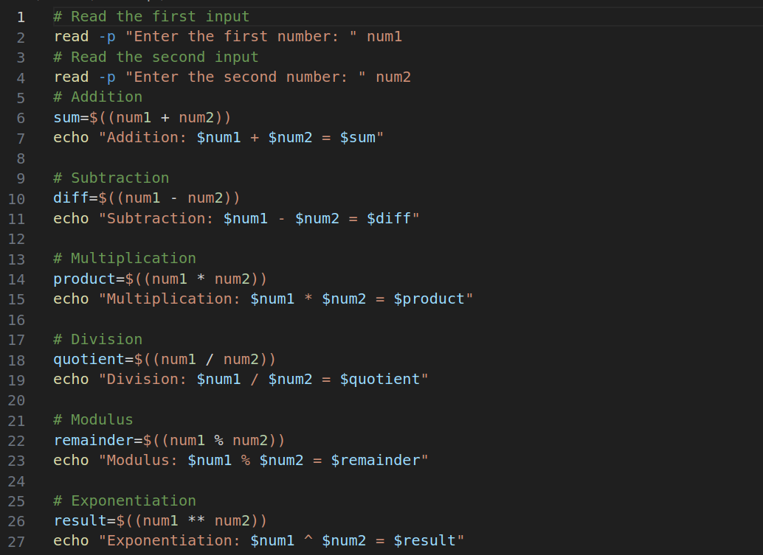
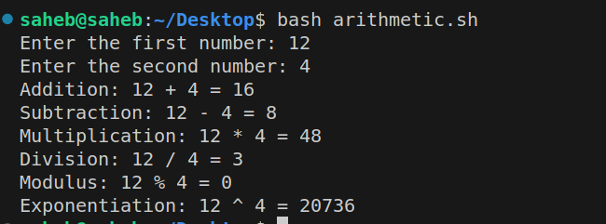
Arithmetic Operators
+ Addition
- Subtraction
* Multiplication
/ Division
% Modulus
** Exponential

Slide 26
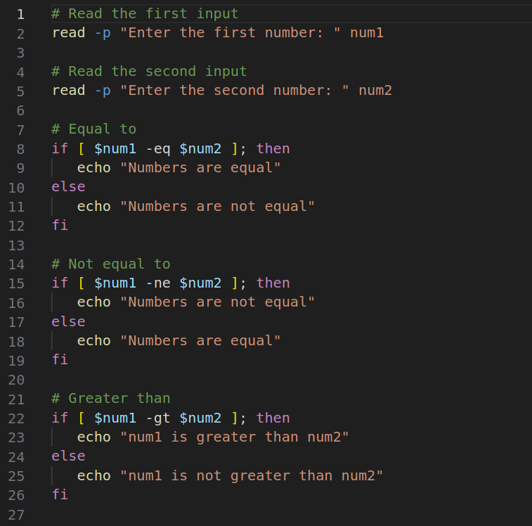
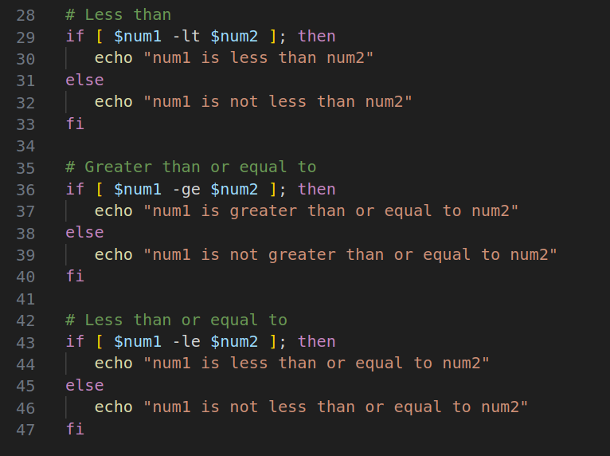
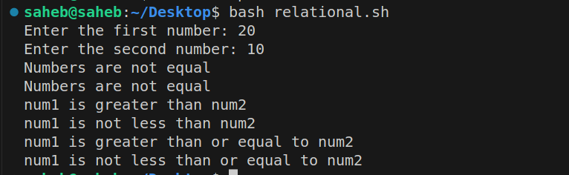
Relational Operators
-eq Equal to
-ne Not equal to
-gt Greater than
-lt Less than
-ge Greater than or equal to
-le Less than or equal to

Slide 27
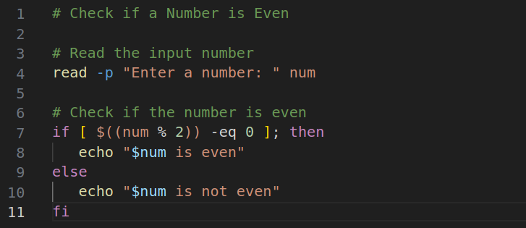
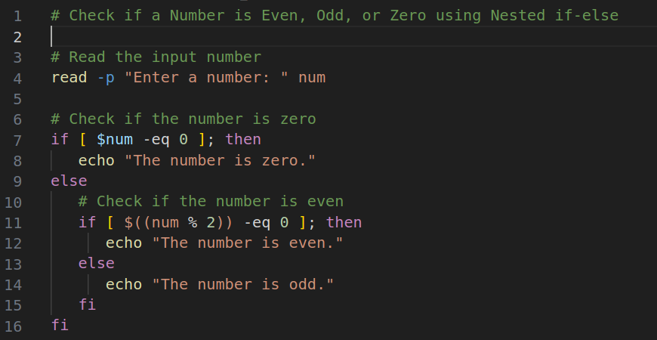
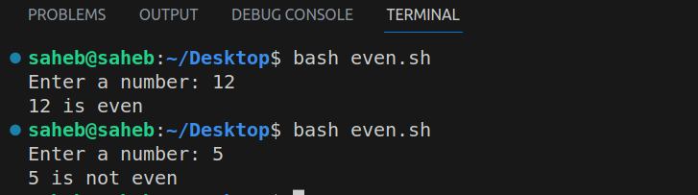
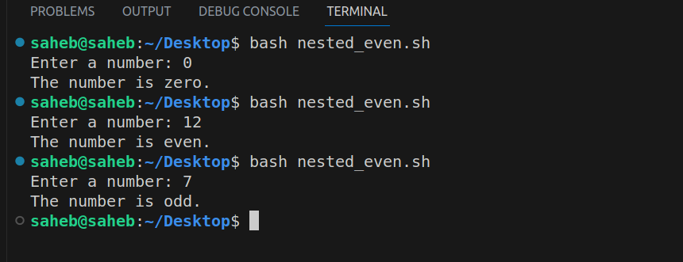
if else and nested if else condition

Slide 28
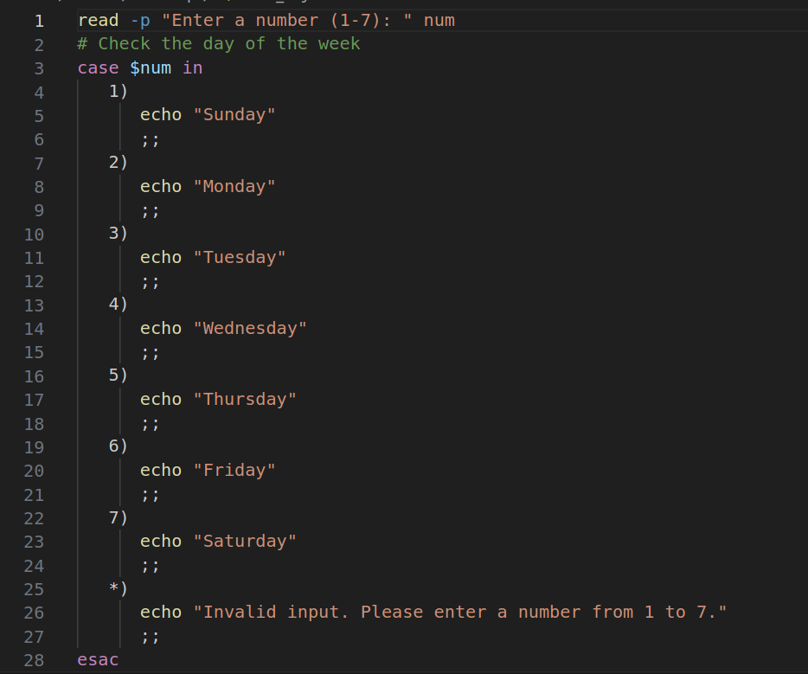
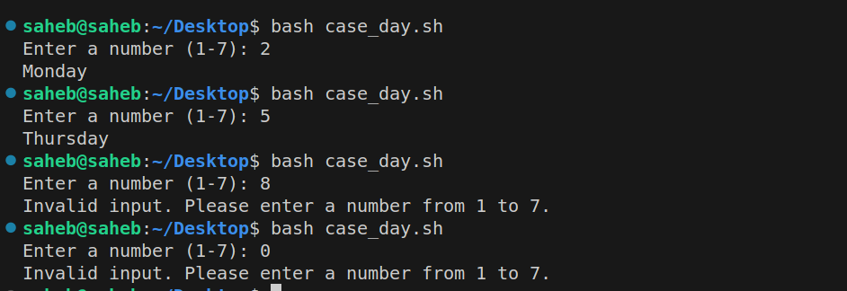
case statement

Slide 29
for loop and while loop
while [ (condition) ]
do
statement 1
statement 2
statement 3
...
done
for iteration_variable in {set of space separated values}
do
statement 1
statement 2
statement 3
...
done

Slide 30
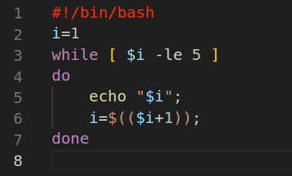
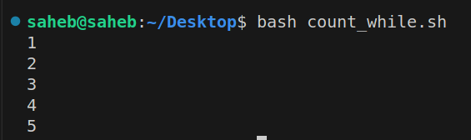
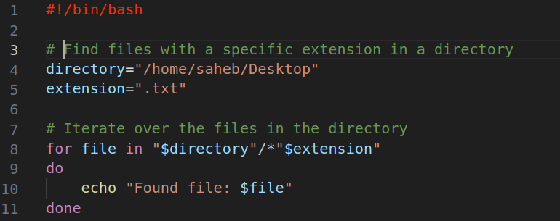
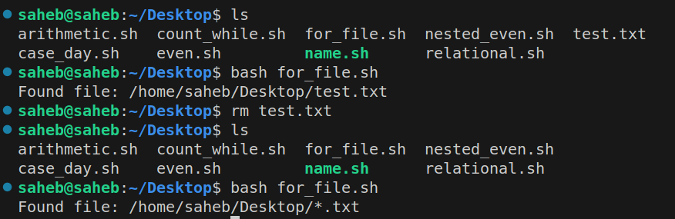
continue..

Slide 31
Thank You

